Slide 1
New IP Sandbox
Leveraging Linux for the design of applications using New IP open platform

Slide 2
Tutorial Overview
Introduction and Setup
Part 1: Introduction to New IP (motivation and format)
Rationale for New IP
Address Innovation
New IP Contracts
New IP Design on Linux
Part 2: New IP Sandbox Test Environment
Introduction to Linux namespaces and NeST topology creation platform.
NeST Design and Features
Platform for New IP Sandboxing
Part 3: Demonstration of the use cases
Forwarding based on Asymmetric addresses
Developing Contracts latency-aware forwarding.
Platform Capabilities
Part 4: Service extensibility on New IP platform
Extension scenario of latency-aware scheduling and forwarding for multiple time constraint streams.
Wrap up

Slide 3




Presenters
Kiran Makhijani
(Futurewei Tech, USA)
Mohit Tahiliani
(NITK, India)
Bhaskar Kataria
(NITK India)
Lijun Dong
(Futurewei Tech, USA)
Deepta and Shanshak (NITK) for support with tutorial and access to New IP VM

Slide 4
Setup
Slides and VM for hands on portion of the tutorial
https://network2030.github.io/NewIP-Linux/
Access Cloud Account to VM
ssh ubuntu@<ip_address>
[Download for your own use]
129.154.224.36
144.24.108.91
144.24.115.88
129.154.224.207
152.67.25.130
144.24.103.180
144.24.118.49
129.154.231.126
129.154.227.93
129.154.226.88

Slide 5
New IP Overview
Basic Specification

Slide 6
Network Requirements
Support for several billions of devices.
Support for a variety of connections
Support for terabytes of high-volume data streams
Translating to Requirements on the Networks
High reliability in machine-centric data delivery
Fine-grained customization of traffic
Guarantees of data delivery
Timeliness, quality, throughput
Loss less flow of traffic between the endpoints
Reliability
New Security aspects
Digital Sovereignty, Preservation of Privacy
Digital Twins & Cyber physical systems.
| Abundant Bandwidth Everywhere
eMBB
mMTC
URLLC
|Connectivity Everything
|Critical Applications and Services
Understand impact of these requirements on the current network architecture
Source: ITU-T IMT-2020

Slide 7
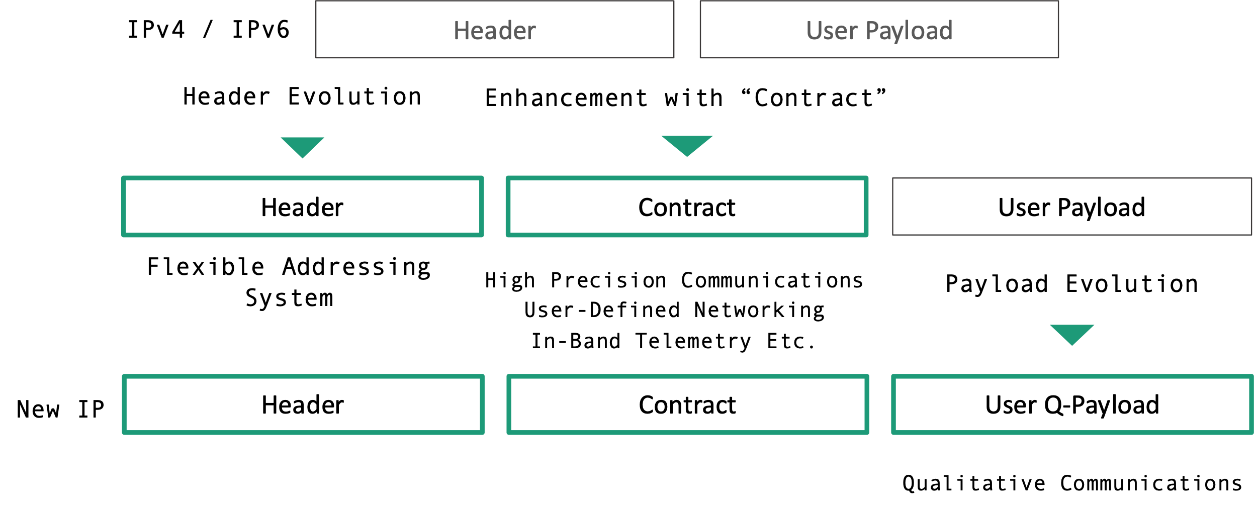
What is New IP?
An abstraction of Network Technologies across different dimensions to enable next-gen application scenarios
Evolutionary Architecture
Self-X Networks
Trustworthiness
High Precision Services
Flexible, Backward Compatible
AI/ML Technologies
Secure routing
New low level service primitives
large-scale network domains
Automation in Mgmt Plane
Customization in Control Plane
Customization in Data Plane
Promotes Holistic approach vs Siloed approach: past few decades network innovation are driven by specific requirement within the constraints of current network architecture
HPC
QC
FAS Sockets
Automation
Transport
Security & Trust
An early stage of concept to support newer applications in evolutionary, flexible and programmable manner
New IP
Layer 2/Data link

Slide 8
New Network Service Primitives
Best Effort
Forward a traffic flow from a network node
Differentiated services
Ingress - Enable classification, Police and mark traffic
Core – Queuing Dropping, Per-hop behavior (PHB) for minimum rate assurance, egress shaping and aggregate traffic
Traffic Engineering
path selection based on constraints on bandwidth
Limitations when dealing with newer applications
Fails to provide throughput guarantees
Fails to provide guarantees of maximum latency (in-time)
Fails to provide guarantees of precise latency (on-time)
Technical Specification:“New Services and Capabilities for Network 2030: Description, Techni​​cal Gap and Performance Target Analysis​” (October 2019) ​
Technical Report: "Network 2030 - Gap Analysis of Network 2030 New Services, Capabilities and Use cases" (June 2020)

Slide 9
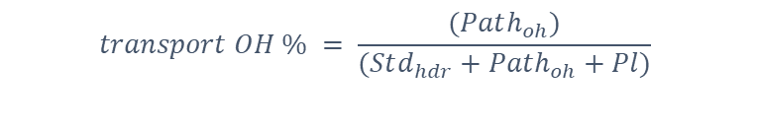
Structured Headers lead to overheads
Tunnel 1
Routing/ Address Headers
͌
Tunnel 2
Service/ Capabilities
͌
$$transport OH \% = \frac{(Path_{oh})}{(Std_{hdr}+Path_{oh}+Pl)}$$
S-Label
payload
C-Label
Integrated services
Observations
telemetry
With Segment routing TE (MPLS or V6) overheads go up with No of hops.
General overhead for 4-byte packet is very high (with Std TCP/IP hdr included)
Segment routing TE vs MPLS has control plane complexity trade offs.
Services continuously evolve using heterogeneous sets of protocols and functions
Different methods of tunneling, load balancing, congestion control and Quality of Service, firewalls and intrusion detection systems.
Example: Transport Backhaul Path overhead

Slide 10
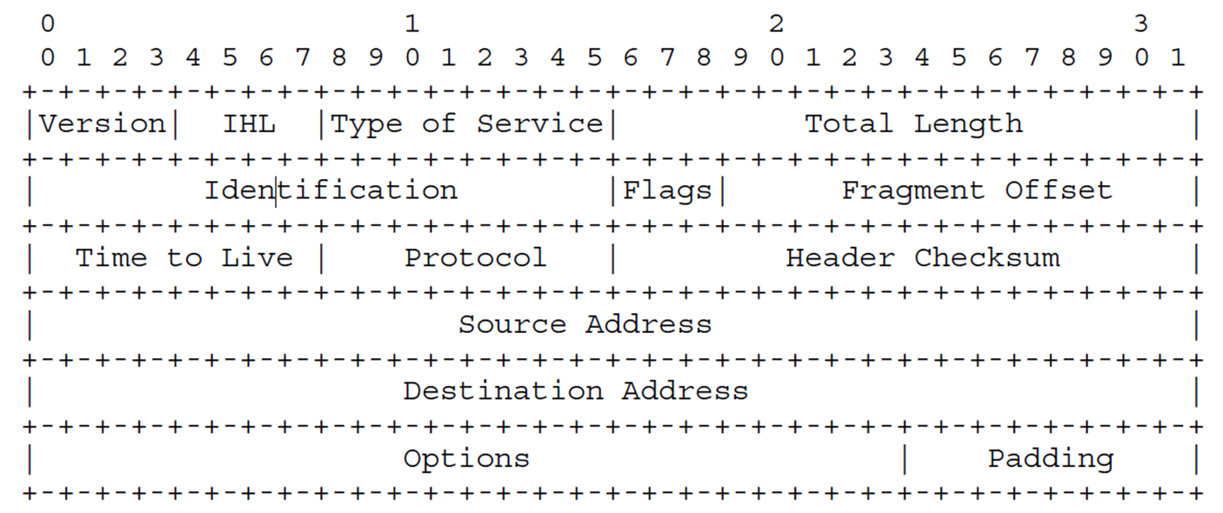
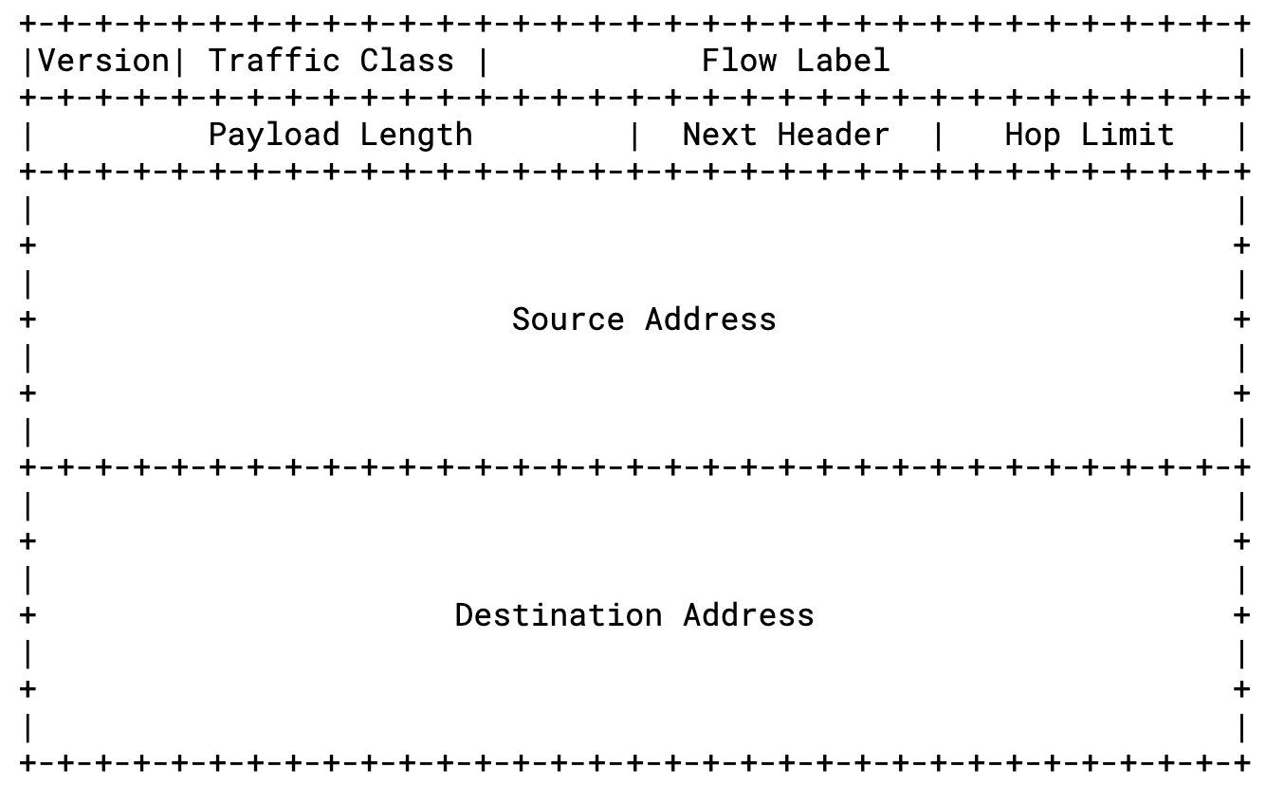
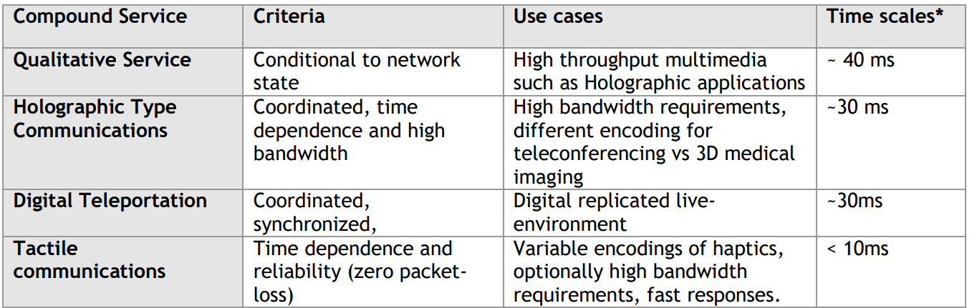
Packet Formats - Services
Missing Information for the Networks and Routers
Throughput for the media application
Latency for the underlying application requires
Other resource requirements the application may have – level of security, path, functions
Additional Primitives: Tracking, Receipt notification, Cost & Energy

Slide 11
Packet Formats - Addresses
Private Networks are growing faster
Higher degree of customizations are required
Control: Managing internal networks like the Internet is not ideal.
Services: Different industries have different requirements.
Addresses: There is no ideal fixed-length or format of an address
Smaller networks should not have to carry overheads of larger fixed-sizes
Smaller payloads + smaller headers improve energy efficiency.
Custom address structures protect networks from well-known vulnerabilities
Global Reachability ≠ Global address space
Symmetrical addresses – should source/destination addresses must belong to same address family?
Diverse range of types of end hosts. E.g., IoT devices need energy efficiency, chunks of distributed media content needs descriptive addressing.
Notes:
The current structure of the addresses imposes homogenous addressing scheme. Both end points must have the same address

Slide 12
Packet Format – Qualitative Payload
Network is blind to Semantics associated with the packets
Payload itself is treated as raw, uninterpreted, unchangeable.
The tolerance to packet losses in the volumetric media applications is extremely low, and the problem
Means to support Qualitative Communications
Network perceives the semantics of the packet payload, e.g., boundary, importance variation, relationship among different parts in the packet;
The unit of action taken by the network does not need to be on the entire packet.
E.g. achieving near linear throughput, if packet losses due to congestion are eliminated.
Notes:
Payload itself is treated as raw, uninterpreted, unchangeable, and lacks intelligent treatments inside the network. When a packet gets dropped or lost completely.
if the network can perceive the semantics of the packet payload, e.g., boundary, importance variation, relationship among different parts in the packet; then the unit of action taken by the network does not need to be on the entire packet, but only on a part of the packet. This may help eliminate re-transmissions in the networks and yet being able to supply data to the receiver with a tolerable quality.

Slide 13
Basic Structure of the New IP Packet
From these observations we conclude that the evolution of the network layer itself is necessary for innovations in the data plane and forwarding planes technologies.
Our proposal is very simple
It describes a packet format that evolves independently across several dimensions.
It maintains network layer as universal – accommodating all types of communications
Is backward compatible
The specification for the new packet format:
The structure is defined using the “Header Spec”
Shipping (Addressing and Reachability functions)
Contract Spec (service specific goals)
Payload Spec (packetization of user payload)
Header Spec is a very small header with offsets to other parts of the structure

Slide 14
New IP Shipping Spec
key features: (a) flexible address format scheme, (b) backward compatible, and (c) hybrid addressing.
Hybrid addressing is supported by allowing both source and destination formats to be specified independently
Address Type (AT) field is the first field routers or nodes look at.
For backward compatibility, AT will use reserved mnemonics such as IPV4, V6, MPLS etc. Then the remaining packet is the classic IP/MPLS.
Otherwise AT can reflect combination of source and destination address types.
Address-cast (Acast) describes communication patterns such as unicast, groupcast, multicast, coordinated-cast etc.

Slide 15
New IP Shipping Spec Examples
Backward Compatibility
For example, IPv4 and MPLS in New IP
In these cases AT will use reserved mnemonics such as IPV4, V6, MPLS etc. Then the remaining packet is the classic IP/MPLS.
Asymmetric Addresses in Shipping Spec

Slide 16
New IP - Contract
A contract is service specification of a service associated with the packet.
It can be optional. Then the contract offset will be set as NA.
Event and Conditions specify when Action take place. – tremendous potential for the research and development of data plane technologies
It can be composed of one or more clauses; Each clause will be a high-level data plane action. For example, in order to support Ultra-Reliable Low Latency (uRLLC) in 5G, two contracts C1 and C2 can be used.
C1 contract clause indicates the BoundedLatency action, and clause
C2 has action NoPktLoss i.e., the low latency and reliability are to be met.

Slide 17
New IP – Q-Payload
The Payload specification is used to support qualitative payload.
The Type field indicates whether it is a traditional or Q-payload.
Q-payload itself needs support from Contract Specification to describe actions on Q-payload.
For example
Wash: a generic operation to arbitrarily or selectively remove the bits/bytes inside the packet payload. For example, remove every 8th bit, remove every fifth byte, etc.
Repair and Recover: can salvage lost portions from the residual payload based on context present along with the action.
Enrich: The re-insert lost portions with locally cached chunks when the network condition improve.
Notes:
The Payload Spec supports Q-Payload. In order to capture the context, it utilizes NewIP contracts. And Q-Payload specific new actions are defined as
Wash, through which selective portions of bits from the packets can be removed
Repair allows Q-paloads to recover the lost data at a different node in the network.

Slide 18
New IP Packet Processing Pipeline
Lookup Tables
IPv4
16-bit
Transit/Runtime state
IPv6
8-bit
params
state
params
state
Ingress Packet
Shipping Spec Parser Engine
Contract spec Engine
Egress processing
New IP out
Scheduler
New IP
Classification
LBF
Ping
CC
contract

Slide 19





Realizing Proof of Concept
IP only network
New IP Nodes
Contract insertion
Address insertion
Queue Contract Scheduling
Shipping Spec processing
Remove/ Process Contract
End point Library
Packet processing and forwarding in network nodes
End point Library

Slide 20
Design Principles
Since New IP Packet format is new and carries a lot of intelligence, it was important to understand those processing overheads from
Design and over all implementation framework perspective
From performance and ease of development
More Focus on packet processing/ not hardware
Emphasis on Fast and flexible test and verification environment
Our Platform choice – Linux with network name spaces
Reuse not reinvent
Linux gave us a very stable environment and a plethora of tools and features.
Very short learning curve
NeST provides meets all the above design considerations

Slide 21
References
Technical Specification: “New Services and Capabilities for Network 2030: Description, Techni​​cal Gap and Performance Target Analysis​” (October 2019) ​
Technical Report: "Network 2030 - Gap Analysis of Network 2030 New Services, Capabilities and Use cases" (June 2020)
R. Li, K. Makhijani and L. Dong, "New IP: A Data Packet Framework to Evolve the Internet : Invited Paper," 2020 IEEE 21st International Conference on High Performance Switching and Routing (HPSR), 2020, pp. 1-8, doi: 10.1109/HPSR48589.2020.9098996.
K. Makhijani and L. Dong, "Asymmetric Addressing Structures in Limited Domain Networks," 2021 IEEE 22nd International Conference on High Performance Switching and Routing (HPSR), 2021, pp. 1-7, doi: 10.1109/HPSR52026.2021.9481811.
IEEE GLOBECOM 2019: Richard Li, “IP: GOING BEYOND THE LIMITS OF THE INTERNET”
6G RESEARCH VISIONS, NO. 6
White paper on 6G networking, Led by Tarik Taleb. https://www.6gchannel.com/items/6g-white-paper-networking/

Slide 22
Thank You
Please contact presenters for questions, feedback, and comments
Mohit P. Tahiliani tahiliani@nitk.edu.in
Lijun Dong lijun.dong@futurewei.com
Bhaskar Kataria bhaskar.181co213@nitk.edu.in
Deepta Devkota deeptadevkota.191cs117@nitk.edu.in
Shashank D shashankd.181co248@nitk.edu.in
Kiran M kiranm@futurewei.com
Acknowledgements: @ameyanrd, @rohit-mp, @lesliemonis

